Slide 1
Town of Chester Proposed Purchase

Slide 2
Thank you for allowing this process to be
OUR PROJECT. We have watched it evolve over the past couple of months since the
opportunity first presented itself.

Slide 3
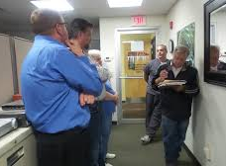
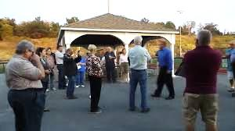
We have collected public input for several months
Community conversations
Town Board Meetings
2 Scheduled Tours of The Rock
Our Open Public Comment Forum

Slide 4
Hopefully we will answer all of your questions during this presentation, however, we will offer a final 15 minute Q&A session upon closing of tonight’s event.

Slide 5
OVERVIEW
What are we talking about exactly?

Slide 6
WHAT IS THE ROCK?

Slide 7
PROPERTY DETAILS
Location: 24 Old Black Meadow Road, Chester
Building: 15,000 sq.ft
Acres: 11.6 -/+
Parking Spaces: Approx. 200
Source of Heat: Forced Air Heating and Cooling
Water Source: Village Water
Currently Zoned as: GC -General Commercial
Possible property use/approval under current zoning laws:
Schools, private schools, colleges
Church or similar praise of worship
Function Hall for private members
Warehouse, Car Wash, Gas Station

Slide 8
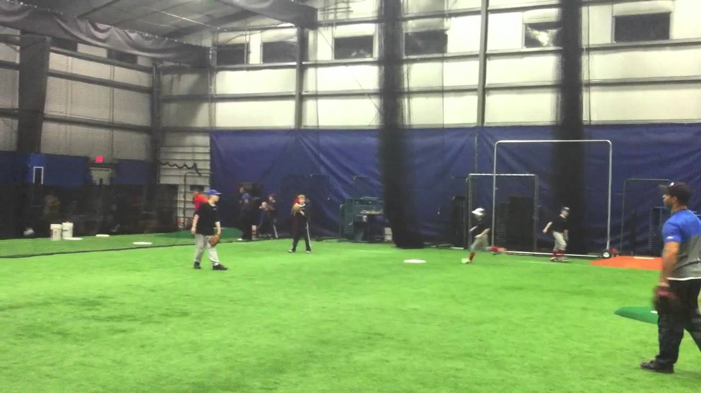

Slide 10
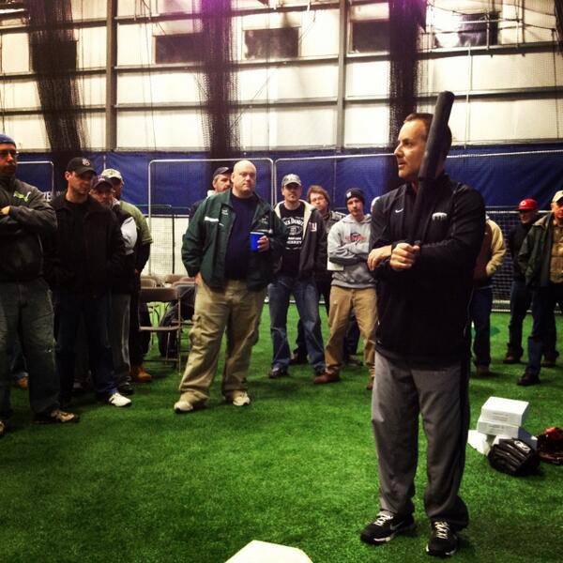
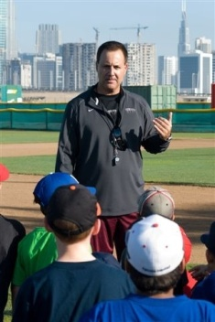
THE ROCK HISTORY
Introduction, the owner and founder of Frozen Ropes

Slide 11
Tony Abbatine
Tony’s vision of children’s services and dedication to help make dreams come true for kids simply had an opportunity to grow after running his Chester business for 22 years.
With his evolution, he hopes to pass the torch- so to speak, and watch the Town of Chester provide a facility to families where they can also enjoy enrichened lifestyles, things to do, and obtain personal growth. Residents of ALL ages can enjoy the multi-faceted amenities The Rock provides.
Tony is invested in the Chester Community and has become part of many of your families. Should the Town of Chester have the chance to take ownership of The Rock, Tony is committed to support all of their initiatives.

Slide 12
HOW WAS THE ROCK BORN?

Slide 14
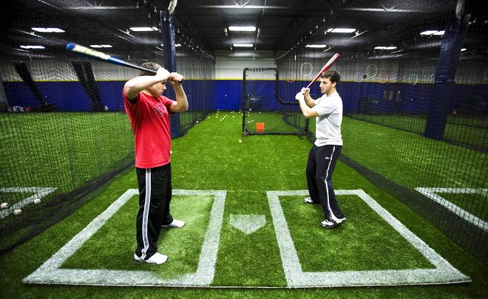
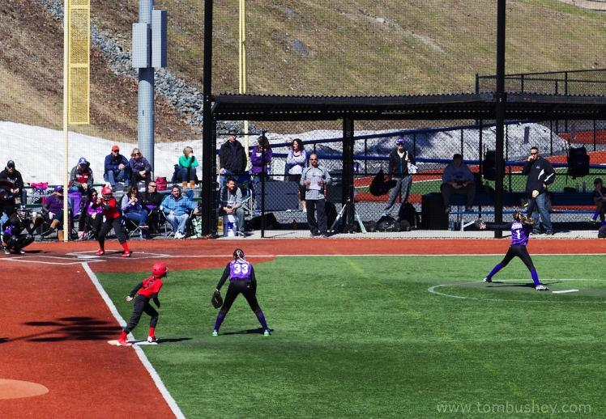

Slide 15
ABOUT ARTIFICIAL GRASS

Slide 16
THE BENEFITS OF TURF
The financial benefit to a FieldTurf field over natural grass is quite simple: The upfront cost is higher, but the cost savings over time make it a much more financially-sound decision.
With a FieldTurf field:
Use more months out of the year
Reduced maintenance requirements
Save on maintenance costs such as re-sodding, watering, fertilizing and mowing
Eliminate harmful chemicals such as pesticides and herbicides

Slide 17
REPLACING WEAR & TEAR
More wear & tear areas get replaced in PATCHES. The entire turf field does not need to be replaced. All existing wear & tear will be replaced with the purchase contract. Existing warranty is transferable to new Owner.

Slide 18
IS IT SAFE?

Slide 19
RESEARCH AND STUDIES
The FieldTurf research resource center is designed to be the most comprehensive collection of documents available. In this section you will find valuable research and general documents pertaining to the safety and performance of artificial turf systems.
HEALTH AND ENVIRONMENT
A Scoping-Level Field Monitoring Study of Synthetic Turf Fields and Playgrounds Prepared by the National Exposure Research Laboratory Office of Research and Development U.S. Environmental Protection Agency with contributions from the Agency’s Tire Crumb Science Workgroup
Summary: All VOCs were measured at extremely low concentrations that are typical of ambient air concentrations. The average extractable lead concentrations for turf blade, tire crumb infill, and tire crumb rubber were low. Although there are no standards for Pb in recycled tire material or synthetic turf, average concentrations were well below the EPA standard for lead in soil (400 ppm). On average, concentrations of components monitored in this study were below levels of concern.

Slide 20
Evaluation of the Environmental Effects of Synthetic Turf Athletic Fields Milone & MacBroom Inc.
Summary: Analysis of the laboratory-based leaching potential of metals in accordance with acceptable EPA methods indicates that metals will leach from the crumb rubber but in concentrations that are within ranges that could be expected to leach from native soil. Lastly, it can be concluded that the use of crushed basaltic stone as a base material in the construction of the athletic fields has a neutralizing effect on precipitation.
AN ASSESSMENT OF CHEMICAL LEACHING, RELEASES TO AIR AND TEMPERATURE AT CRUMB-RUBBER INFILLED SYNTHETIC TURF FIELDS New York State Department of Environmental Conservation, New York State Department of Health
Summary: Analysis of crumb rubber samples digested in acid revealed that the lead concentration in the crumb rubber samples were well below the federal hazard standard for lead in soil and indicate that the crumb rubber from which the samples were obtained would not be a significant source of lead exposure if used as infill material in synthetic turf fields. A public health evaluation was conducted on the results from the ambient air sampling and concluded that the measured levels of chemicals in air at the Thomas Jefferson and John Mullaly Fields do not raise a concern for non-cancer or cancer health effects for people who use or visit the fields.

Slide 21
NEWS from CPSC U.S. Consumer Product Safety Commission
Summary: The U.S. Consumer Product Safety Commission (CPSC) staff concludes that young children are not at risk from exposure to lead in these fields.
STAPH / MRSA
A Survey of Microbial Populations in Infilled Synthetic Turf Fields Andrew S. McNitt, PH.D Soil Science Dianne Petrunak, M.S. Plant Pathology
Summary: In conclusion, there are generally lower numbers of total microbes present in the infill or fibers of the synthetic turf systems tested compared to natural turfgrass rootzones and Staphylococcus aureus bacterium were not found on any of the playing surfaces. Staphylococcus aureus bacterium were found on towels and other devices used to train athletes.
Chemicals and particulates in the air above the new generation of artificial turf playing fields, and artificial turf as a risk factor for infection by methicillin-resistant Staphylococcus aureus (MRSA) Literature review and data gap identification Office of Environmental Health Hazard Assessment, California Environmental Protection Agency
Summary: It seems unlikely that the new generation of artificial turf is itself a source of MRSA, since MRSA has not been detected in any artificial turf field.
SAFETY

Slide 22
Incidence, Causes, and Severity of High School Football Injuries on FieldTurf Versus Natural Grass: A 5-Year Prospective Study Michael C. Meyers,*† PhD, FACSM, and Bill S. Barnhill,‡ MD From the †Human Performance Research Center, West Texas A&M University, Canyon, Texas, and ‡Panhandle Sports Medicine Associates, Amarillo, Texas
Summary: The epidemiological study concluded that FieldTurf is safer than natural grass in several key areas, such as: 44% Fewer Concussions, 33.4% Lower ACL Trauma, 26.6% Fewer Severe Injuries and 33.4% Fewer Ligament Tears.
Incidence, Mechanisms, and Severity of Game-Related College Football Injuries on FieldTurf Versus Natural Grass: A 3-Year Prospective Study Michael C. Meyers,* PhD, FACSM From the Department of Health and Human Development, Montana State University, Bozeman, Montana
Summary: The epidemiological study concluded that FieldTurf is safer than natural grass in several key areas, such as: 12% Fewer Concussions, 40% Lower ACL Trauma, 20.6% Fewer Severe Injuries and 31.4% Fewer Ligament Tears

Slide 23
THE TOWN OF CHESTER

Slide 24
WHY DO WE WANT THE ROCK?
Add value to your homes/real estate by providing the Community with a "Gem"- to call our own
Increased Park & Rec ran programs for all ages
Save annual expenditures -now providing additional local things to do, activities, classes and community events
Improved Summer Camp
Keep Community spending local- by offering MORE in our own backyard- keeping and attracting customers to shared businesses

Slide 25
Provide Facility Rental for Organizations, Personal Use and local Businesses to offset expenses
Outdoor Fields
Indoor Gymnasium
Indoor Multi-Use Turf
Fitness Trail
Class /Conference/ Meeting/ Party Rooms
Support local Businesses by extending use of facility for their special events
Provide a Storm Ready/Emergency Facility for our Community and neighboring region

Slide 26
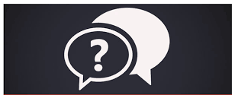
FACT FINDING
You asked, we answered.
Frequently asked questions

Slide 27
Q? ARE WE LOOKING TO PURCHASE "FROZEN ROPES" AND RUN A BUSINESS?
A: NO! We are proposing to purchase The Rock - The FACILITY, for sole use of the Town of Chester Recreation, Emergency Services and Community Amenities only.
We will be able to RENT out the facility- to offset costs to:
To Frozen Ropes during the 5 year transition period for us all
Various Organizations that run their own Tournaments after the first 5 years
Other local organizations, private parties and local Businesses
Hosts of Expos’ and other large Community events
Town's intent is not to run any business - franchise like Frozen Ropes.

Slide 28
Q? IS THERE INTENTION TO CONVERT THE ROCK- THE FACILITY- TO OUR COMPLETE TOWN HALL/MUNICIPAL CENTER?
A: No. This is to use as our Town’s Parks & Recs.
However, we are not going to say, "No, never"- because by purchasing The Rock, the building will be added to our Town owned property inventory. If we should ever have to assess (compare) the overall best plan to renovate or expand, and The Rock is the best overall, most cost efficient plan, vs. investing more monies in older buildings, so be it.
But the immediate and foreseen plan is simply to remove any Town Hall "basement" offices to The Rock, and allow our existing Town Hall the room to shift in organization and storage. (This would include Parks & Recs, Building & Water Depts).

Slide 29
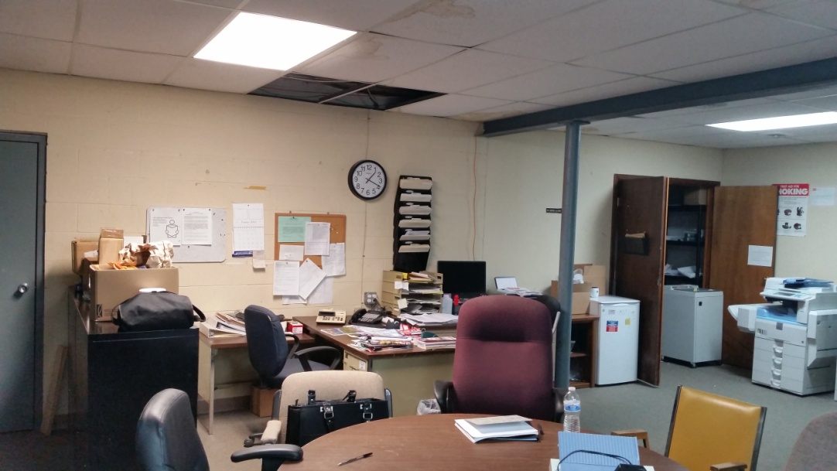
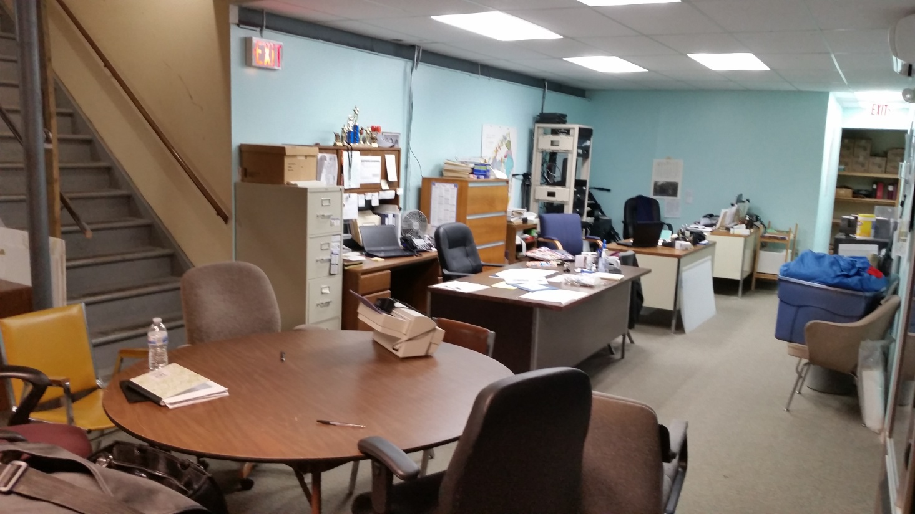
CURRENT BASEMENT OFFICES AT
TOWN HALL

Slide 30
WHO WILL OVERSEE IT?

Slide 31
CHESTER TOWN BOARD
SUPERVISOR, ALEX JAMIESON: experience-Banking, #’s
ROBERT VALENTINE: experience- Construction, family owned business- business owner
CLAUDE BRISCHOUX: experience- Real Estate, past Chester Chief of Police
CINDY SMITH: experience- Facility Lighting, lifelong resident with stellar networking
DONALD WITTEKIND: experience- Linen Company, very involved in children’s community services , Chester High School graduate
* After the property appraisal was complete and we confirmed The Rock was a purchase the Town can realistically consider, MR. BRISCHOUX – the Seller’s listing Agent has recused himself from all further negotiations and discussions pertaining to The Rock. The Town will not utilize a (Buyer’s) Real Estate Agent, we will use our Town Lawyer for all transactions.

Slide 32
WHO WILL RUN IT?

Slide 33
MEET THE TOWN PARKS & REC STAFF
Walter Popailo
Kristin Palmer
Lori Streichert

Slide 34
PLANS OF USE
What’s all of this for?

Slide 35
INCREASE PROGRAMS, CLASSES, EVENTS
Heart Healthy Cooking
Health & Wellness
Chat & Paint
Exercise Boot Camp
Seniors Exercise
Volley Ball
Dodge Ball
Ceramics
Line Dancing
Movie Nights
Parents Night Out
Festival of Lights
Town Garage Sale
Tween/Teen Lounge
& MUCH MORE!
We want to hear YOUR suggestions!

Slide 36
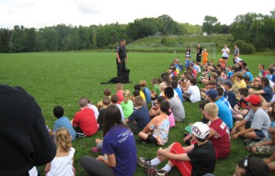
EXPAND ON SUMMER CAMP
Additional Sessions
Longer Hours –Early Drop off/ Late Pick Up

Slide 37
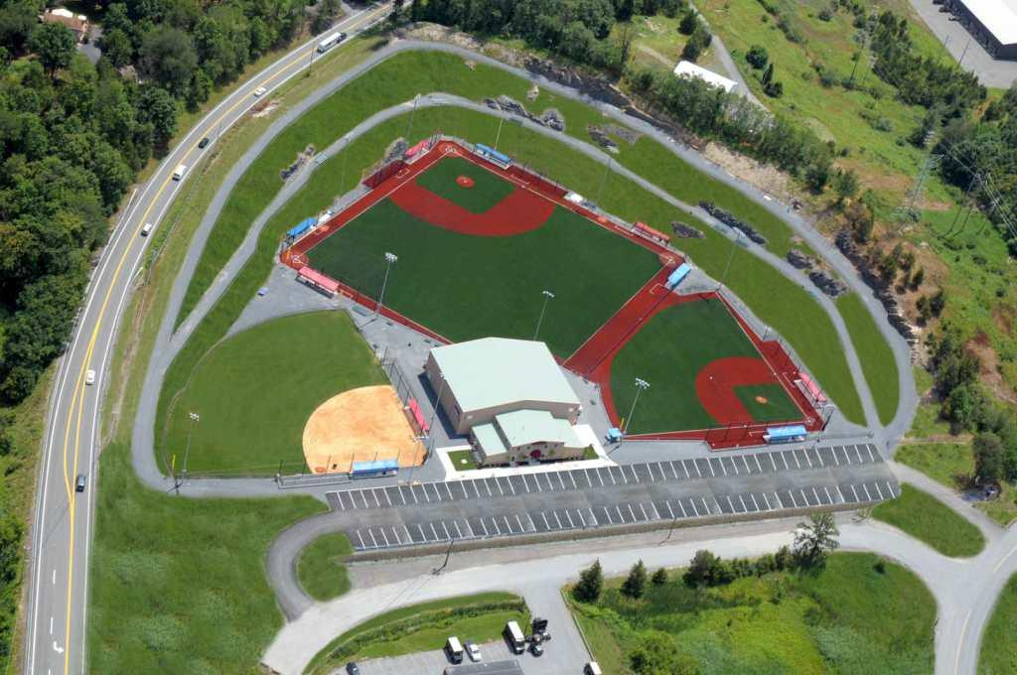
WHAT’S AVAILABLE TO USE?

Slide 38
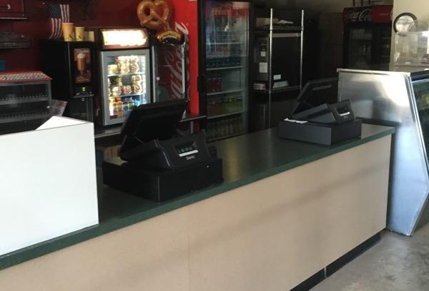
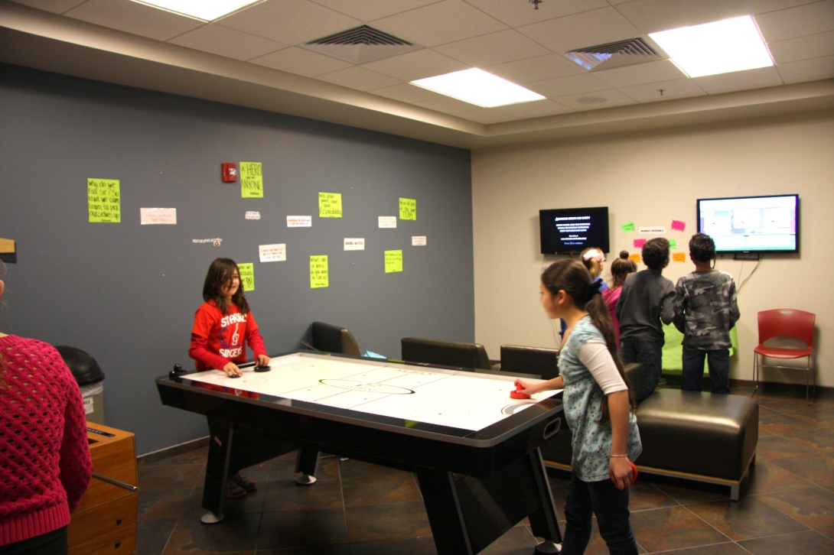
INDOORS
Events Room
Conference Room
Kitchen
Teen/Tween Lounge

Slide 39
INDOORS
Hard Floor Space
Turf Space

Slide 40
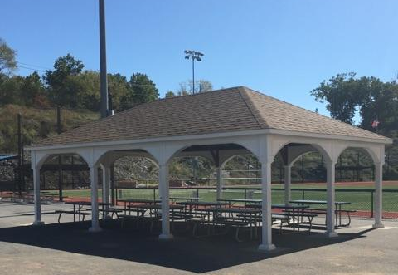
OUTOORS
Pavilion

Slide 41
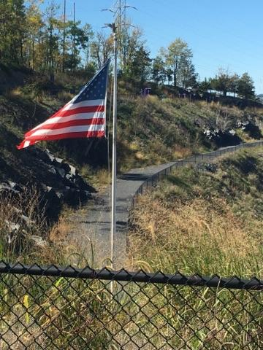
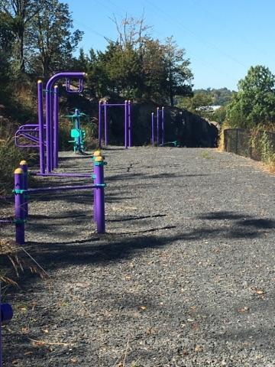
Fitness Trail
Circuit Training Trail

Slide 42
3 Constructed Fields include:
5 Playing Fields, 1 Soccer Field, 2 Fitness Trails

Slide 43
SUPPORT OF FROZEN ROPES
Frozen Ropes, a 22 year business in Chester, will be a valuable resource to the facility.

Slide 44
TO OFFER A STORM READY FACILITY
A Registered Emergency Shelter for the town of Chester and neighboring towns
Grants available
Government funded
Cots, generators and all ER supplies significantly discounted or free

Slide 45
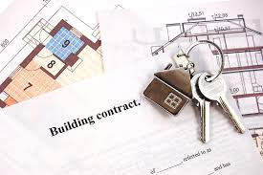
THE SALE
Listing Price: 3.5 Million
Agreed Sale price: 3.2 Million

Slide 46
Restricted Use Appraisal: 2.79 mm Report Received: May, 2016
Based on
Full Deed Restriction/ NO INCOME RENTAL
(which has since been lifted)
No account of 4 Acres of Fitness Trails / community walking paths

Slide 47
THE PURCHASE
Purchase Price: 3.2 mm
Bond Interest Rate: 1.35%
Expense over 30 Years: $3,893,400
What was expense of Knapp’s view?
Purchase Price: 4.4 mm
Bond Interest Rate: 3.625%
Expense over 15 Years: $5,704,223

Slide 48
WHAT WE NEGOTIATED IN THE SALE
3.3 mm > 3.2 mm
Lifted Deed Restriction
Restriction only for the first 5 years
Only pertains to Major Tournaments
All other Income Rental is permitted
Frozen Ropes will rent fields 20 weekends/year for the first 5 years as a transition period for all
Will retrofit indoor turf to ½ Hard Floor and partition system for Turn Key readiness
To include a bigger bundle of existing furniture, fixtures, equipment and maintenance machinery (details as followed)

Slide 49
What’s “TURN KEY CONDITION” for OUR needs
Reconfiguration of indoor turf space
Purchase & install 50’x80’ portable hard floor
Purchase & install partition dividing system

Slide 50
Current Floorplan
Main Rec Area: 85’ x 110’
Currently all indoor Turf

Slide 51
Turn Key Floorplan
Split Rec Area
85’ x 110’
Area #1: 85’ x 60’
Including 85’ x 50’ Hard Flooring
Area #2: 85’ x 50
Remains indoor Turf for multi-use
#1
#2

Slide 52
Sample of Indoor Divider

Slide 53
WHAT’S INCLUDED IN THE PURCHASE?
Grounds
2 Gazebos
2 Sheds
Turf Groomer
One Golf Cart
Fitness Trail Equipment
Bleachers/Benches
Portable Fencing
Indoors
Perimeter nets
Ceiling nets
Blue wall padding
Front reception counter
Select office furniture
Bleachers/Benches
All major Concession Stand fixtures, display cases and appliances

Slide 54
FINANCIALS
How much will it actually cost?

Slide 55
How does it fit in the Big Picture?
Plans for the Senior Center
Plans for The Police Station
And now I’ll show you The Rock &
how it will effect you?

Slide 56
TAX RATE
Tax Rate | 2016 | 2017
General and HWY Townwide | $ 4.81 | $ 4.68
Part Town | $ 3.56 | $ 3.28
Highway Part Town | $ 1.06 | $ 1.35
Tax Rate per $1,000 assessed value | $ 9.43 | $ 9.31

Slide 57
THE BUDGET

Slide 58
Appropriations | 2017 Budget | 2018 Budget | 2019 Budget | 2020 Budget | 2021 Budget | At Year 10 | YR 20
THE ROCK
Personal Services | $ 57,200 | $ 58,916 | $ 83,563 | $ 86,070 | $ 100,092 | $138,914 | $186,688
Maintenance | $ 75,000 | $ 78,750 | $ 82,688 | $ 86,822 | $ 91,163 | $110,809 | $180,496
DEBT SERVICE | $ 129,780 | $ 129,780 | $ 129,780 | $ 129,780 | $ 129,780 | $129,780 | $129,780
Total Expenses | $ 261,980 | $ 267,446 | $ 296,031 | $ 302,672 | $ 321,035 | $379,503 | $496,964
Debt Service - $3.2 million dollar bond @ |  | 1.35%
Maintenance
Utilities | $ 35,000
Custodial | $ 15,000
General Repairs | $ 20,000
Maintenance Repairs | $ 5,000
Total | $ 75,000
Personal Services
5 PT employees- 20 hrs @11 per hour calculated:
$220 weekly @ 52 weeks = $11,440 x 5 employees
REVENUE TOTALS:
Frozen Ropes rental | $ 32,400 | $ 32,400 | $ 32,400 | $ 32,400 | $ 32,400 | $ - | $ -
Pavilion Rental | $ 2,350 | $ 2,350 | $ 2,350 | $ 2,350 | $ 2,350 | $ 11,750 | $12,500
Concession Stand | $ 43,600 | $ 45,780 | $ 52,647 | $ 65,809 | $ 98,713 | $ 144,525 | $235,414
Vending Machine | $ 3,000 | $ 3,090 | $ 3,183 | $ 3,278 | $ 3,377 | $ 4,200 | $5,000
Indoor/Outdoor Rental | $ 15,000 | $ 15,750 | $ 18,113 | $ 22,641 | $ 33,961 | $ 49,722 | $80,991
Field Rental |  |  |  |  |  | $ 34,020 | $55,415
Total Revenues | $ 96,350 | $ 99,370 | $ 108,692 | $ 126,478 | $ 170,801 | $ 244,217 | $ 389,320
Net Cost | $ 165,630 | $ 168,076 | $ 187,339 | $ 176,195 | $ 150,235 | $ 135,286 | $ 107,644
Cost to taxpayers | $ 31.25 | $ 31.71 | $ 35.34 | $ 33.24 | $ 28.34 | $ 25.52 | $ 20.31

Slide 59
Appropriations | 2017 Budget |  | 2018 Budget | 2019 Budget | 2020 Budget | 2021 Budget | At Year 10 | YR 20
THE ROCK
Personal Services | $ 57,200 |  | $ 58,916 | $ 83,563 | $ 86,070 | $ 100,092 | $138,914 | $186,688
Maintenance | $ 75,000 |  | $ 78,750 | $ 82,688 | $ 86,822 | $ 91,163 | $110,809 | $180,496
DEBT SERVICE | $ 129,780 |  | $ 129,780 | $ 129,780 | $ 129,780 | $ 129,780 | $129,780 | $129,780
Total Expenses | $ 261,980 |  | $267,446 | $ 296,031 | $ 302,672 | $321,035 | $379,503 | $496,964
Debt Service - $3.2 million dollar bond @ |  |  | 1.35%
Maintenance
Utilities | $ 35,000
Custodial | $ 15,000
General Repairs | $ 20,000
Maintenance Repairs | $ 5,000
Total | $ 75,000
Personal Services
5 PT employees- 20 hrs @11 per hour calculated:
$220 weekly @ 52 weeks = $11,440 x 5 employees
EXPENSES

Slide 60
REVENUE
 | 2017 Budget |  | 2018 Budget | 2019 Budget | 2020 Budget | 2021 Budget | At Year 10 | YR 20
REVENUE TOTALS:
Frozen Ropes rental | $32,400 |  | $32,400 | $32,400 | $32,400 | $32,400 | $ - | $ -
Pavilion Rental | $2,350 |  | $2,350 | $2,350 | $2,350 | $2,350 | $11,750 | $12,500
Concession Stand | $43,600 |  | $45,780 | $52,647 | $65,809 | $98,713 | $144,525 | $235,414
Vending Machine | $3,000 |  | $3,090 | $3,183 | $ 3,278 | $3,377 | $ 4,200 | $5,000
Indoor/Outdoor Rental | $15,000 |  | $ 15,750 | $18,113 | $ 22,641 | $ 33,961 | $ 49,722 | $80,991
Field Rental |  |  |  |  |  |  | $ 34,020 | $55,415
Total Revenues | $ 96,350 |  | $ 99,370 | $108,692 | $126,478 | $ 170,801 | $244,217 | $ 389,320
Net Cost | $165,630 |  | $168,076 | $187,339 | $176,195 | $150,235 | $135,286 | $107,644
Cost to taxpayers | $ 31.25 |  | $ 31.71 | $ 35.34 | $ 33.24 | $ 28.34 | $ 25.52 | $ 20.31
Note: The concession Stand will go out to bid, pay rent for space & pay a % of sales to The Town. The town will not be running the food services. Monies collected on all revenue is to offset costs only.

Slide 61
COST TO TAX PAYERS
 | 2017 Budget |  | 2018 Budget | 2019 Budget | 2020 Budget | 2021 Budget | At Year 10 | YR 20
Cost to taxpayers | $ 31.25 |  | $ 31.71 | $ 35.34 | $ 33.24 | $ 28.34 | $ 25.52 | $ 20.31

Slide 62
ASSESSMENT EXAMPLE
Assessment Example
Assessment per $1,000 | 0.21
Home Value of $300,000
Equalization rate of 63%
Assessment value : 189,000 | $ 39.69
Tax Rate | 2016 | 2017
General and HWY Townwide | $ 4.81 | $ 4.68
Part Town | $ 3.56 | $ 3.28
Highway Part Town | $ 1.06 | $ 1.35
Tax Rate per $1,000 assessed value | $ 9.43 | $ 9.31
Rock Assessment | 0.21
Tax Rate decrease from 2016 to 2017 | 0.12
Rock assessment modified | 0.09
Home Value of $300,000
Equalization rate of 63%
Assessment value : 189,000 | $17.01

Slide 63
HOW DO WE SECURE THE ROCK?
Vote YES on November 8th at the General Elections.
NOTE:
You are voting to secure THE BOND, allowing us to move forward with the actual purchase.
We chose to add this to the November Ballot, as to NOT incur additional expenses for a Special Vote on any later date.

Slide 64
IN CLOSING
Thank you for being a part of the process , allowing this to be OUR PROJECT,
and adding this crowned jewel to our Community!

Slide 65
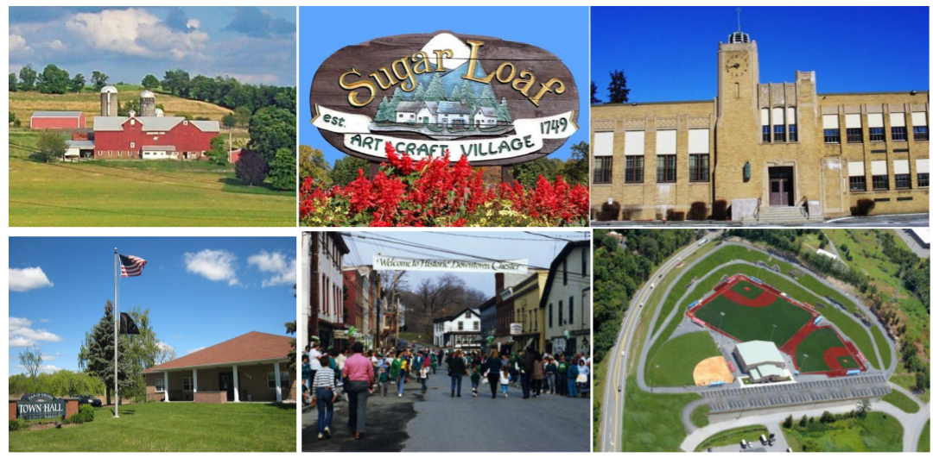
THE TOWN OF CHESTER

