Slide 1

Town of Chester
Comprehensive Plan and Zoning
Worksession
November 19, 2025

Slide 2
Goals in Preparing the Zoning Amendments
Implement many of the goals of the draft Comprehensive Plan.
  The proposed zoning amendments touch upon 26 of the stated goals set forth in the proposed implementation schedule of the Draft Comprehensive Plan.
Bring the zoning code, particularly application processes in line with the NYS Enabling Statutes and with NYS case law.
  Establish a Special Use Permit process.
  Clarify the Site Plan Application process.
Reconcile inconsistencies within the Zoning Code.

Slide 3
History of the AR.-3, Schools and Religious Institutions
Prior to 2017, Schools and religious institutions were permitted in the AR.-3 as a permitted use subject to site plan. The specific requirements of those uses were found in § 98-29 of the Zoning Code.
In September of 2015, the Town adopted the 2015 Comprehensive Plan Updates.
  That plan recognized three goals in relation to Camp Monroe –
    Page 43 – Recognizes that the 2003 Comp Plan recommended acquiring for Town Park
    Page 47 – Extend the Highlands Trail through the Camp Monroe properties through public/private partnership to provide a direct connection to the Appalachian Trail.
    Page 95 – “Clustering, conservation easements, or incentive zoning are all tools that could be considered to preserve a portion of Camp Monroe as parkland.

Slide 4
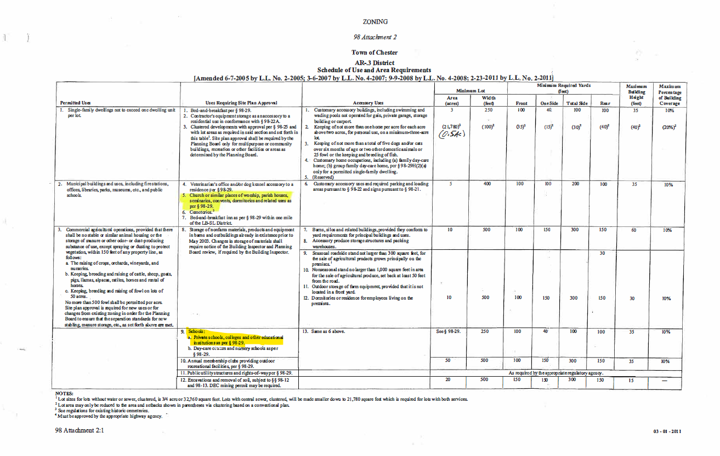

Slide 5
In 2017, the Town Board adopted Local Law 1 of 2017 on September 27, 2017.
“This local law is intended to protect the public health, safety and welfare of the community by implementing certain recommendations of the Town of Chester’s 2015 Comprehensive Plan. It is further intended to protect property values, protect the physical appearance of the community, preserve the scenic and natural beauty, and ensure that certain non-residential uses are situated within those areas of the Town with the infrastructure to support them. …….
This local law strengthens the special permit requirements for religious institutions and schools to balance the potential impacts on neighbors and local roadways, while ensuring ample opportunities to situate these institutions within the Town.”

Slide 6
What did Local Law 1 of 2017 do?
Despite the fact that the Comprehensive Plan did not discuss treatment of religious uses, the LL eliminated religious uses and schools outright in the entire AR.-3 zoning district (approx. 70% of the Town).
Rezone portions of Camp Monroe from SR-2 to AR.-3
Prohibited existing religious institutions including the Bruderhoff Community rendering them non-conforming.
It also eliminated day care centers, nursery schools and annual membership clubs providing outdoor recreational activities.
It retained excavation and removal of soil – i.e. mining - as a permitted use.

Slide 7
What did Local Law
1 of 2017 NOT do?
Implement any goal of the 2015 Comprehensive Plan as they related to Camp Monroe (Clustering, incentive zoning, etc). The 2015 Comprehensive Plan did not contain any recommendations regarding religious use.
Undergo SEQR review as required. (And neither did the 2015 Comprehensive Plan Updates).
  There is no record of a vote by the Town Board with regard to SEQR for either document.
Establish a special permit process or standards for religious uses (or any other uses) despite the stated intent of strengthening special permit requirements.

Slide 8
Legal Authority
NYS Rule
1st Amendment
Federal
RLUIPA
Common Law
Police Power

Slide 9
Religious Use Case Law – It’s not just RLUIPA
The law is well-settled that religious and educational institutions "enjoy special treatment with respect to residential zoning ordinances because these institutions presumptively serve the public's welfare and morals" - Matter of Lawrence School Corp. v Lewis, 174 AD2d 42, 46 (2d Dept 1992).
In Cornell University v. Bagnardi, 68 NY2d 583 (1986), the NY Court of Appeals wrote "the total exclusion of educational and religious institutions from a residential district serves no end that is reasonably related to the morals, health, welfare and safety of the community …. Since a municipality's power to regulate land use is derived solely from its right to use its police powers to promote these goals, such total exclusion is beyond the scope of the localities' zoning authority" See also Matter of Westchester Reform Temple v Brown, 22 NY2d 488 (1968); Diocese of Rochester v. Planning Board of Brighton, 1 NY2d 508 (1956); Community Synagogue v. Bates 1 NY2d 445 (1956)
These cases all pre-date the enactment of RLUIPA in 2000
Notes:
Westchester Reform Temple - it must be convincingly shown that the Temple's proposed expansion will have a direct and immediate adverse effect upon the health, safety or welfare of the community
Diocese of Rochester - We do not believe it a proper function of government to interfere in the name of the public to exclude churches from residential districts for the purpose of securing to adjacent landowners the benefits of exclusive residential restrictions."

Slide 10
Where a municipality imposes more stringent requirements upon a religious use than it would on a residential use, such requirements are viewed with suspicion (see, Jewish Reconstructionist Synagogue v Incorporated Vil. of Roslyn Harbor, 38 NY2d 283, 288 (1975). See also Apostolic Holiness Church v. Zoning Bd. Of Appeals, 220 A.D.2d 740 (2d Dept 1995).
Notes:
Both cases – religious uses could not apply for a variance from a set back where commercial uses could; impacts could be mitigated through conditions

Slide 11
RLUIPA
RLUIPA provides that "[n]o government shall impose or implement a land use regulation in a manner that imposes a substantial burden on the religious exercise of a person, including a religious assembly or institution, unless the government demonstrates that imposition of the burden on that person, assembly, or institution . . . is in furtherance of a compelling governmental interest; and is the least restrictive means of furthering that compelling governmental interest." 42 U.S.C. § 2000cc(a)(1)

Slide 12
So does that mean religious and educational uses have carte blanche????

Slide 13
No.
In the Bagnardi case, the Court “explicitly rejected any argument that ‘appropriate restrictions may never be imposed with respect to a church and school and accessory uses.’”
It went on to find that the beneficial effect on the community can be rebutted “with evidence of a significant impact on traffic congestion, property values, municipal services and the like.”
In Pine Knolls Alliance Church v. Zoning Bd. Of Appeals, 5 NY3d (2005), the Court of Appeals wrote, “We have invalidated ordinances that impose blanket bans on religious or educational uses in particular communities in favor of a case-by-case review, endorsing the special use permit application process as the proper procedure for addressing expansion requests This procedure "affords zoning boards an opportunity to weigh the proposed use in relation to neighboring land uses and to cushion any adverse effects by the imposition of conditions designed to mitigate them.“
  In that case, the Court upheld a ZBA’s determination not to authorize a secondary driveway.

Slide 14
So what does all this mean for the
Town of Chester?

Slide 15
The proposed zoning amendments seek to implement an individualized approach endorsed by the Courts vs a blanket prohibition of religious and school uses in the AR-3 Zoning District which represents 70-75% of the Town’s landmass.
Each and every religious and school use Town wide must undergo special permit, site plan and SEQR review with the Planning Board
It is through this process that sites such as Camp Monroe will undergo an individualized environmental review including traffic impacts, impacts on water/sewer, environmental impacts, noise impacts, stormwater and the like.
Notes:
Some are of the mind that in the absence of regulations – religious institutions remain unregulated.

Slide 16
What is a Special
Use
Permit?
A Special Use Permit is defined by § 274-b of the Town Law as “an authorization of a particular land use which is permitted in a zoning ordinance or local law, subject to requirements imposed by such zoning ordinance or local law to assure that the proposed use is in harmony with such zoning ordinance or local law and will not adversely affect the neighborhood if such requirements are met.” Town Law § 274-b further authorizes a board to impose reasonable conditions and restrictions on a special permit use.

Slide 17
A special permit procedure affords zoning boards an opportunity to weigh the proposed use in relation to neighboring land uses and to cushion any adverse effects by the imposition of conditions designed to mitigate them. Cornell University v. Bagnardi, 68 NY 2d 583 (1986).
After engaging in the appropriate balancing process, zoning officials may conclude that "a particular educational or religious use may actually detract from the public's health, safety, welfare or morals" and may deny a special use permit on that basis. When the negative impacts are not so extreme as to warrant outright denial, mitigating conditions may be imposed to ameliorate the harm "provided they do not, by their cost, magnitude or volume, operate indirectly to exclude such uses altogether". In assessing a special permit application, zoning officials are to review the effect of the proposed expansion on the public's health, safety, welfare or morals, concerns grounded in the exercise of police power, "with primary consideration given to the over-all impact on the public welfare" Trustees of Union College v. Members of the Schenectady City Council, 91 N.Y.2d 161 (1997)

Slide 18
The
Proposed Zoning Amendments
Section § 98-31 – Adds a special use permit application process.
The Planning Board must determine the following objectives can be met:
  The proposed use shall be deemed to be compatible with adjoining properties, and with the natural and built environment of its surrounds.
  The site is accessible to fire, police, and other emergency vehicles.
  The use is suitable to its site upon consideration of its scale and intensity in relation to environmentally sensitive features, including, but not limited to, steep slopes, floodplains, wetlands, and watercourses. Adequate screening and separation distances are provided to buffer the use from adjacent properties where the authorized board deems it necessary.
  The use will not negatively impact ambient noise levels, generate excess dust or odors, release pollutants, generate glare, or cause any other nuisances.
  Parking shall be sufficient so as to not create a nuisance or traffic hazard on adjacent properties or roads.
  Vehicular, pedestrian and bicycle circulation, including levels of service and roadway geometry, shall be safe and adequate to serve the use.
  The location, arrangement, size, operation including hours of operation, and design of the use, including all principal and accessory structures associated with same, shall be compatible with the character of the neighborhood in which it is situated and shall not hinder or negatively impact the use, enjoyment or operation of adjacent properties and uses.
  Utilities, including stormwater, wastewater, water supply, solid waste disposal and snow removal storage areas, shall be adequate to serve the use.

Slide 19
The Proposed Zoning Amendments, cont.
The Bulk Tables clearly identify which uses are a special use permit by the notation (SUP).
§ 98-29 sets forth additional criteria for specific uses including § 98-29 (F) for religious institutions and § 98-29 (O) for schools of general instruction. These criteria are intended to address and mitigate potential impacts. This approach has been found to be appropriate by Orange County Department of Planning.
§ 98-31 Authorizes the Planning Board to require periodic renewal as a condition of approval. “Renewal may be withheld upon a determination by the authorized board that such conditions as may have been prescribed by the authorized board in conjunction with the issuance of the original permit have not been or are being no longer complied with.”

Slide 20
Other Tools in the Comprehensive Plan and Zoning Amendments
Enhancement to the Cluster regulations where proposed development is clustered away from environmentally constrained lands and to preserve open space.
  Example Oak Woods Subdivision
Establishment of a Community Preservation Fund to provide a mechanism to fund acquisition of land or development rights.
  Governor Hochul signed legislation authorizing a CPF on October 17, 2025.
Strengthen Ridge Line Protection requirements and the needs of the visual impact analysis.
Eliminate excavation and removal of soil as a permitted use.
Provide greater flexibility to agricultural uses in the form of agritourism to diversify farm income and to encourage farming within the Town

Slide 21
Treatment of Camp Monroe
There is no site-specific zoning amendment for Camp Monroe.
  Camp Monroe representatives did not participate in the drafting of the text of the zoning code.
  There is no proposal before the Town for future expansion.
The existing seasonal camp operates as a pre-existing non-conforming use and there are few restrictions applicable to the property including the restrictions on seasonal. This existing use would be permitted to continue regardless even if the Board does not adopt the change to the AR.-3.
Camp Monroe, as with anyone property, can be redeveloped into other uses permitted under the zoning code including year-round uses.
  There are no restrictive covenants apparent on the land use records.
  The Town does not have standing to enforce deed restrictions between private property owners.
Any change to the use or layout of Camp Monroe will require a site plan, special use permit and site specific SEQR review. In addition, buildings would need to be brought up to current NYS Building code as the vast majority of structures on site are not constructed for year-round occupancy.

Slide 22
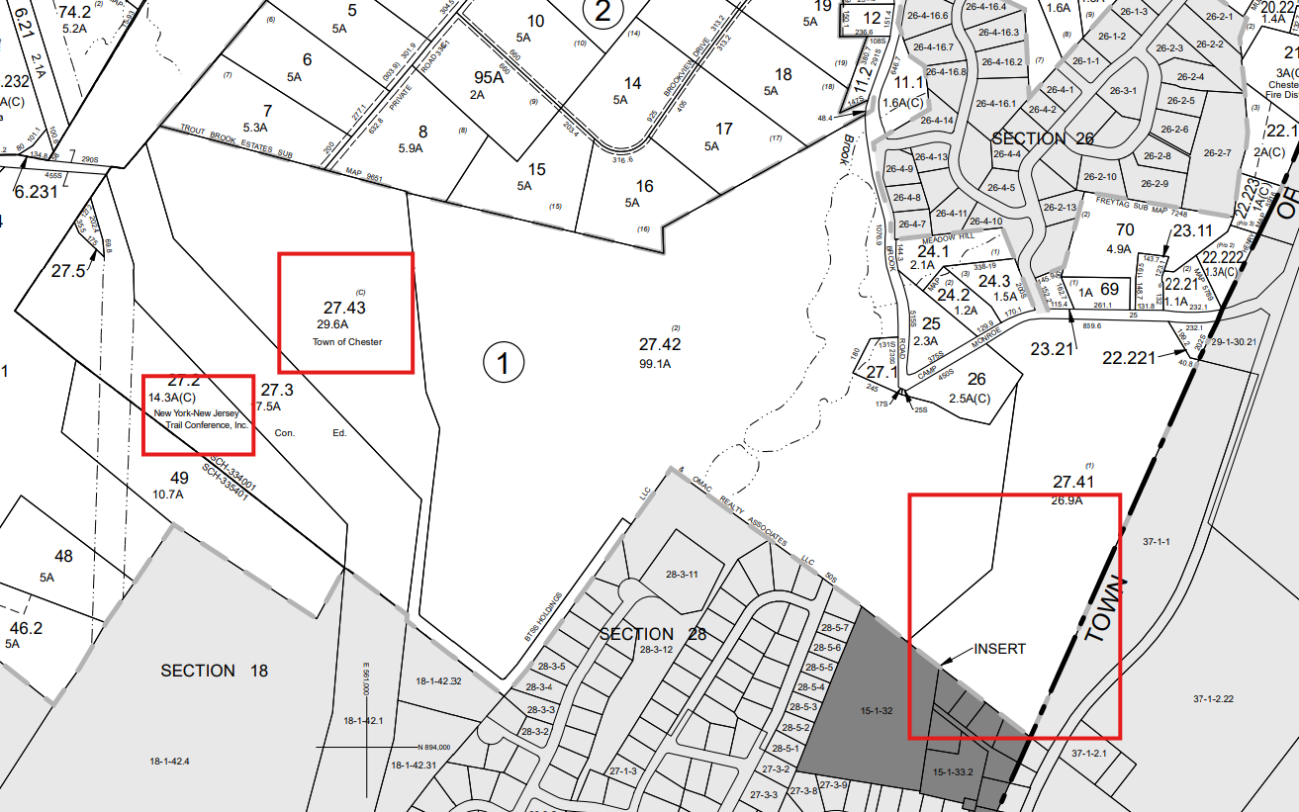
Notes:
28-3-12 = Wilson Park and Town’s sewage facility

Slide 23
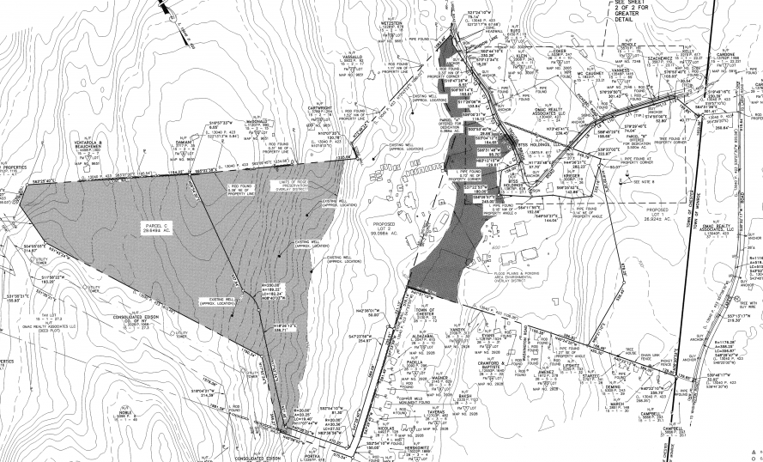
Notes:
Ridgeline Overlay – Again a chunk was given to Chester
Flood Plain and Ponding Area Environmental Overlay

Slide 24
Input from the Board
Chester Conservation Advisory Council.
  Requested changes to the implementation matrix.
Orange County Department of Planning – 239 Response.
  Comments on Comprehensive Plan

Slide 25
Public Notice
Comment – Wishes to broaden the usage of public notice signs. The Town Board may wish to consider including actions that trigger an environmental impact statement (i.e. where there is a positive declaration).

Slide 26
Buffering and Landscaping
Buffering Standards – clarify inconsistencies between bulk table and vs. 98-19
  LB – Footnote 1 – Changed for consistency with 98-19
  I and IP – zoning table to be made consistent with 98-19
  GC – the foot note was eliminated because it merely referenced the buffer provisions with no alteration to the resulting zoning.
  This was a carry over from previous tables. Table and 98-19 to be made consistent. Board to provide guidance as to which standard should apply.
  The table reflects the recommendation of CPC. 98-19C has a greater standard of 200 feet
Treatment of term “adjacent”

Slide 27
Agri-tourism
Amended text to reflect Committee comments.
Board may wish as part of agritourism to specify “craft breweries” and limit to smaller on-site production.

Slide 28
Accessory Uses
PB recommended making accessory uses in 98-11 consistent with the bulk table. I would recommend importing the language of 98-11 into the bulk table.
Customary Residential Accessory Uses include greenhouses, garages, sheds, tool houses, playhouses, wading pools or swimming pools, sports courts all incidental and subordinate to the residential use of the premises and not operated for gain.
verses
Customary accessory buildings, including swimming and wading pools not operated for gain, private garage, sheds, storage building or carport.

Slide 29
Clustering
Level of Town Board Involvement

Slide 30
Battery Storage
Requests for additional research
Notes:
In the absence of regulation, these facilities are often installed under the broad utility use which has limited local regulation.

Slide 31
Change of Use
Seasonal to year-round and site plan

Slide 32
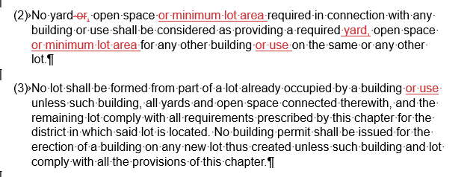
98-6

